Slide 1

XB6/XB7 FAN Test Fixture User Guide
By Foxconn RD Gavin Zhang
January 1st, 2019

Slide 2
1.Download Firmware to Fan fixture
1.1 Install J-Link Drive
1.2 Fan Fixture and computer download mode hardware connection
1.3 Download Firmware to Fan fixture
2.Test Fan fixture Function
2.1 Fan Fixture and computer normal mode hardware connection
2.2 Install Fan Fixture Drive for Windows (If the computer doesn't recognize it properly )
2.3 Open COM port Test tools verify Fixture function
1

Slide 3
1. Download Firmware to Fan fixture

Slide 4
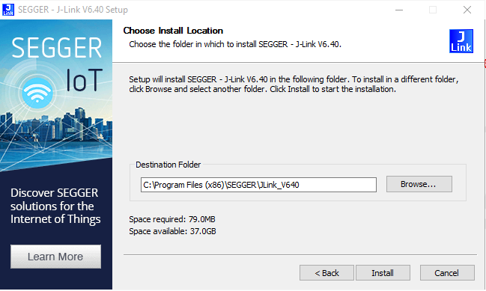
1.1 Install J-Link Drive
J-Link Software and Documentation pack for Windows32 bit: JLink_Windows_V640.exe
2

Slide 5
1.2 Fan Fixture and computer download mode hardware connection
FAN Fixture
STM32 Core Board
VCC 3.3
PC - Windows
SWDIO
J-link OB
USB Cable
SWCLK
GND
Micro-USB
Host-USB
2

Slide 6
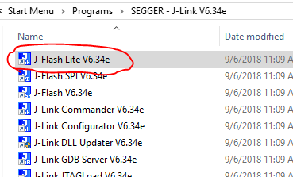
1.3 Download Firmware to Fan fixture
1. Connect the HW cable
2. Open J-link tools location C:\ProgramData\Microsoft\Windows\Start Menu\Programs\SEGGER - J-Link V6.40
3. Launch the J-Flash Lite V6.40
2

Slide 7
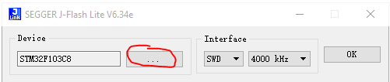
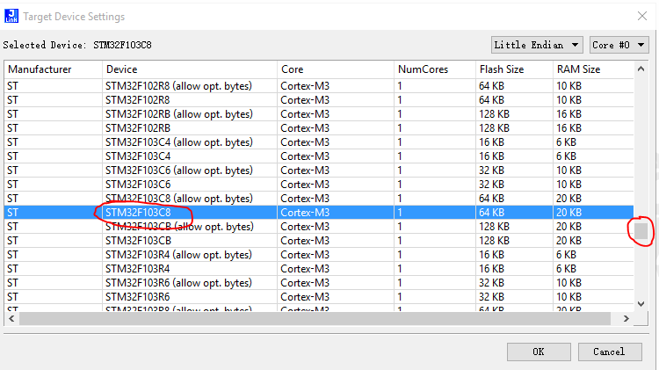
4. Choose IC model
4.1Click More Button
4.2 Select IC Item
“STM32F103C8T6”
4.3 Click OK Button

Slide 8
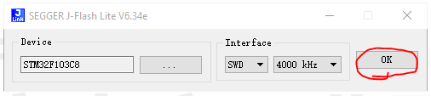
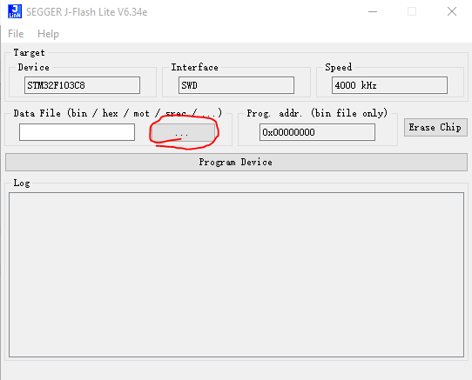
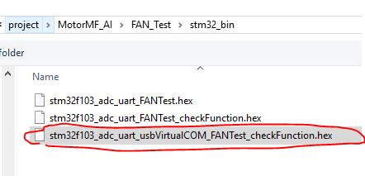
5. Download Firmware
5.1 Click OK Button
5.3 Select hex file
stm32f103_adc_uart_usbVirtualCOM_FANTest_checkFunction.hex
5.2 Click More Button

Slide 9
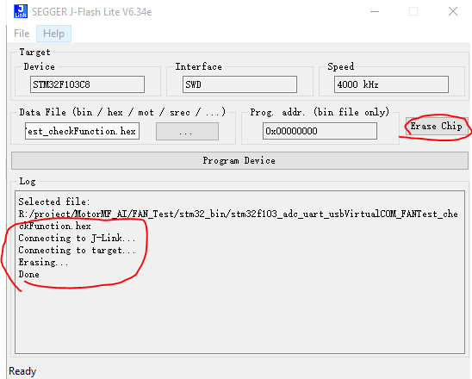
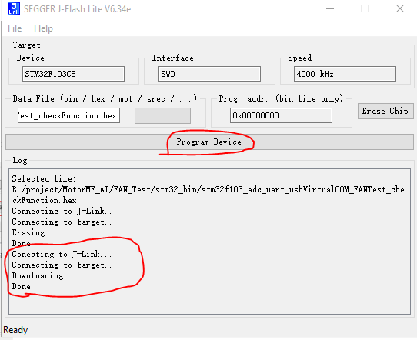
5. Download Firmware
5.4 Click Erase Button
5.5 Click Program Device Button
5.6 If download OK, you can disconnect from your PC and close the J-link software.

Slide 10
2. Test Fan fixture Function

Slide 11
2.1 Fan Fixture and computer normal mode hardware connection
PC - Windows
FAN Fixture
STM32 Core Board
USB Cable
Micro-USB
Host-USB

Slide 12
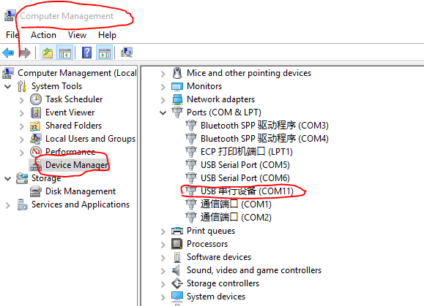
2.2 computer will automatically identify the driver
(If the computer doesn‘t recognize it properly, need install Fan Fixture Drive for Windows )
You can see that the computer has discovered new COM hardware devices

Slide 13
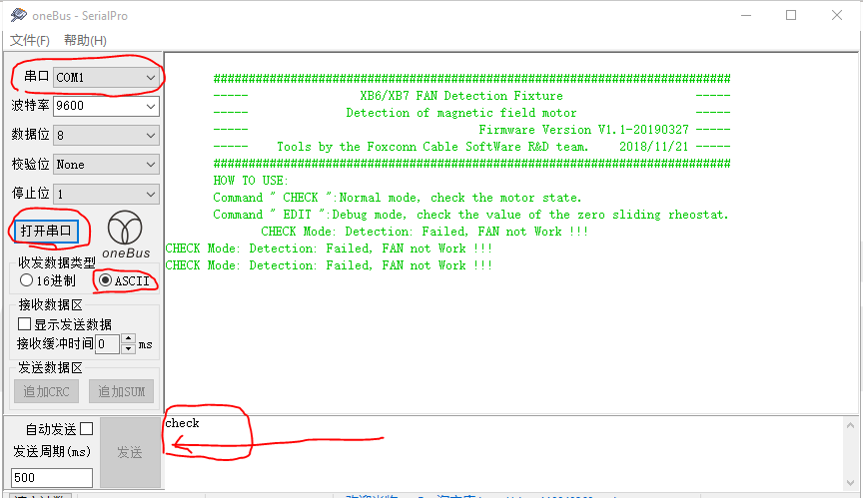
2.3 Open COM port Test tools verify Fixture function
Press enter on the keyboard

